Slide 1
Cardiovascular Disease Prediction with Machine Learning-Based Clinical Decision Support System
Team5:
Tejasree Kilari
Naga Satwika Kakarla
Lakshmi Durga Bhavani Meesala
Kamaluddin Syed
Shamshik Sai Peddoju
Team 5:
T

Slide 2
Abstract:
Heart disease, a prevalent and life-threatening condition, has emerged as a leading cause of global mortality in recent decades. Addressing this critical health challenge necessitates the development of a dependable, precise, and practical diagnostic system. Machine learning techniques offer a promising avenue for tackling this issue effectively.
The central objective of this project revolves around leveraging machine learning algorithms to predict the occurrence of heart disease in patients, thereby advancing the field of medical diagnostics.
Kamaluddin

Slide 3
Introduction:
Heart disease stands as a prominent global cause of illness and death, with an increasing annual toll. The complexity arises from the multitude of contributing risk factors, making it challenging to pinpoint effective solutions, especially for high-risk patients. These risk factors encompass conditions like diabetes, high blood pressure, and elevated cholesterol levels.
Accurate prediction of heart disease plays a pivotal role in averting life-threatening situations, as erroneous predictions can have fatal consequences.
To enhance the overall effectiveness of our predictive model, the application of Machine Learning Algorithms is essential in achieving more precise heart disease identification. We are considering a range of Machine Learning Algorithms, including Logistic Regression, Random Forest, Support Vector Machine (SVM), AdaBoost, K-Nearest Neighbor Classifiers, Naive Bayes, and decision trees to accomplish this objective.
Kamaluddin

Slide 4
Problem Statement:
Heart Stroke is one of the most significant causes of mortality in the world today. Prediction of cardiovascular disease is a critical challenge in the area of clinical data analysis.
Machine learning (ML) has been shown to be effective in assisting in making decisions and predictions from the large quantity of data produced by the healthcare industry.
The main goal of this proposed work is to build a solution that should be able to predict whether a person is diagnosed with Heart Disease or not. The system is developed based on Machine Learning Classifiers.
Kamaluddin

Slide 5

Objective:
The objective of this project is to improve the accuracy of predicting heart strokes in individuals with high-risk factors by using various machine learning classifiers.
Heart strokes are a leading cause of death, but early identification and treatment can save lives.
To achieve this goal, we employed a range of machine learning classifiers and assessed their performance by calculating accuracy and utilizing confusion matrices.
Our aim is to enhance the accuracy of heart stroke prediction and identify the most suitable machine learning classifier for classifying heart diseases.
Kamaluddin

Slide 6
Literature Survey:
S.No | Paper | Methodology | Merits and Demerits
1 | Data-Driven Heart Disease Prediction by Ensemble Feature Selection and Machine Learning Techniques https://ieeexplore-ieee-org.proxy.library.kent.edu/document/10054998 | Feature Selection and Hybrid ML method | Pros: Early detection, Easy diagnosis, More accuracy, Better performance Cons: Small data set is used, Not compactible for larger dataset, Less number of attributes are used
2. | Optimization Accuracy of Heart Disease Diagnosis using Machine Learning Approach https://ieeexplore-ieee-org.proxy.library.kent.edu/document/9971872 | Hybrid ML method | Pros: Accuracy is good the early detection of disease is possible upto 84% Cons: Data complexity is difficult to handle, Model is not compactible
3. | Real-Time Cloud-Based Patient-Centric Monitoring Using Computational Health Systems https://ieeexplore.ieee.org/abstract/document/9770291 | IOT and ML classifiers | Pros: diagnosis Improvement, Remote patient monitoring, Improved access to healthcare, Real-time insights Cons: Cybersecurity issues, False alarms, Lack of human interaction,Costs and regulations issues.
Lakshmi

Slide 7
S.No | Paper | Methodology | Merits and Demerits
4. | Heart Disease Identification Method Using Machine Learning Classification in E-Healthcare https://ieeexplore-ieee-org.proxy.library.kent.edu/document/9112202 | Feature selection Algorithm and Hybrid ML classifiers | Pros: Support Vector Machine classifier is used for efficient prediction of Heart Disease. The model proposed using SVM is memory efficient. It is also effective when the count of dimensions in the dataset is greater than the those of samples. Cons: The dataset used in base paper have only few observations which may result in low accuracy. Some features in the dataset are given high importance whereas the remaining features are given less importance. The SVM classifier fails when the dataset is huge
5. | Machine Learning Based Stream-Lit API Multi-Disease Detection https://ieeexplore-ieee-org.proxy.library.kent.edu/document/10220660 | Using API and ML classifiers | Pros: A webpage for the user interface is created, Disease detection is more easy, By Python a webpage is created, Patients amount is also saved Cons: A more friendly user interface should developed, Overfitting should avoid to get more accuracy for different data, Inaccurate results(patient may enter wrong values),Some unpredictable values
Lakshmi

Slide 8
S.No | Paper | Methodology | Merits and Demerits
6. | Machine Learning Based Clinical Decision Support System for Early COVID-19 Mortality Prediction https://www.frontiersin.org/articles/10.3389/fpubh.2021.626697/full | Hybrid ML classifiers | Pros: Early disease detection, Accuracy is good, Continuous patient monitoring, Contact Tracing, Differentiate between alive and death patient Cons:F1 score is reduced from day to day, Inconsistency, Overfitting ,Model Interpretability is difficult.
7. | Coronary Artery Disease prediction using Machine Learning Techniques https://ieeexplore-ieee-org.proxy.library.kent.edu/document/9785140 | Sampling and classification | Pros: Random oversampling and SMOTE are used for better data balance. Improved performance on imbalanced data, Simple to implement, Accuracy is good Cons: Overfitting, Noise: Random oversampling can introduce noise into the dataset, Runtime complexity because of SMOTE
Lakshmi

Slide 9
Goals:
We are doing qualitative research we had studied wide range of papers related to our Project and had a clear view of our goals:
Implemented Advanced Machine Learning Algorithms to get more accuracy in the heart disease prediction (Than previous projects).
Better dataset is extracted with more attribute information. (The smaller dataset is used in previous projects we had used the newest dataset)
Data visualization is used for displaying the relation between features and target. (In other papers only some feature-target relation is displayed we had included all the features)
We identified the important features which affect the target and neglected less affected features by using different methods.
Lakshmi

Slide 10
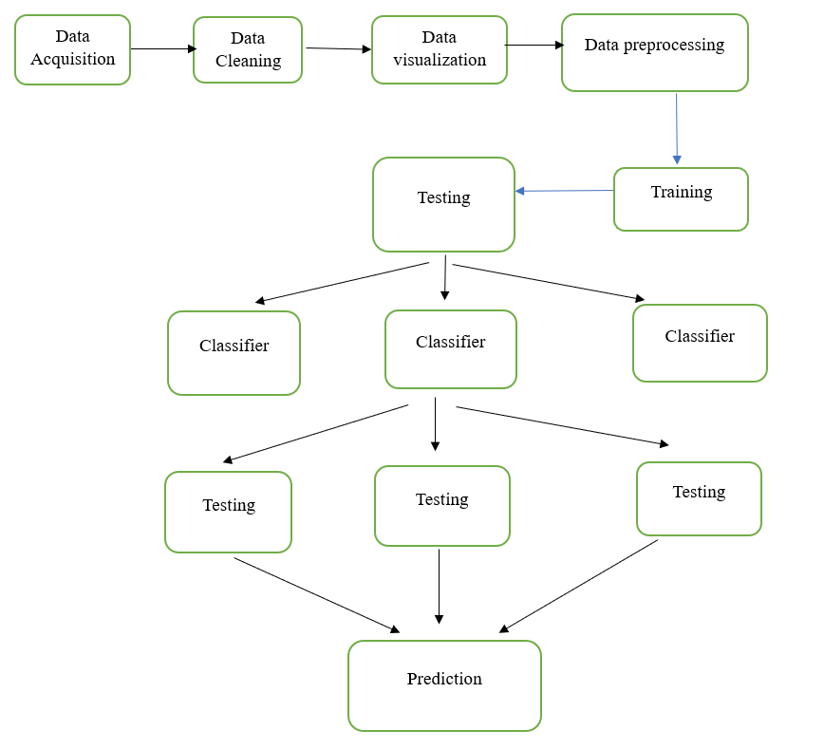
Methodology:
Shamshik

Slide 11
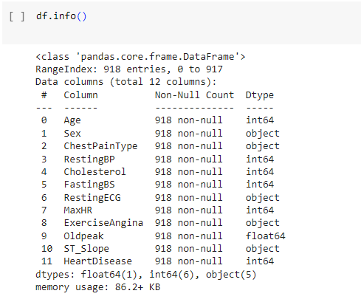
Data Acquisition:
The Dataset is taken from UCI website.
The dataset is available at https://archive.ics.uci.edu/dataset/45/heart+disease
This dataset contains 11 features that can be used to predict a possible heart disease.
The dataset contains 12 attributes, including the predicted attribute. The target field “heart disease” refers to the presence of heart disease in the patient.
It is integer-valued: 0 = no heart disease
1 = heart disease.
This dataset contains a total number of 918 observations, 11 features and one target.
Shamshik

Slide 12
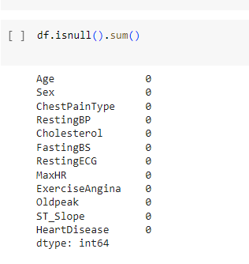
Data Cleaning:
We have thoroughly checked the data set for empty values and duplicate values also we clean the data and make it more flexible for the further process.
Shamshik

Slide 13
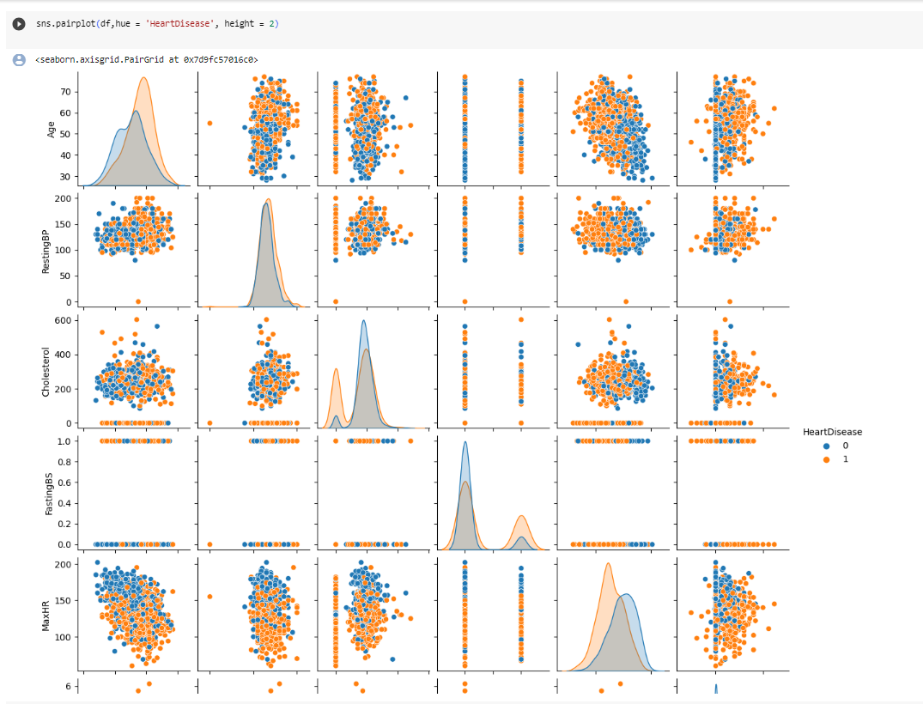
Data Visualization:
Visualization is a powerful tool for simplifying complex data and uncovering patterns that aid in informed decision-making for treatment, prevention, and research related to the target variable.
By employing visualization, we can determine the most influential features on the target variable and identify any outliers that may need to be removed to improve accuracy.
In our project, we used pairplots to visualize the relationships between the features and the target variable.
These visualizations helped us identify an outlier in the form of a resting blood pressure value of zero, prompting us to remove it from the dataset for improved data quality.
Shamshik

Slide 14
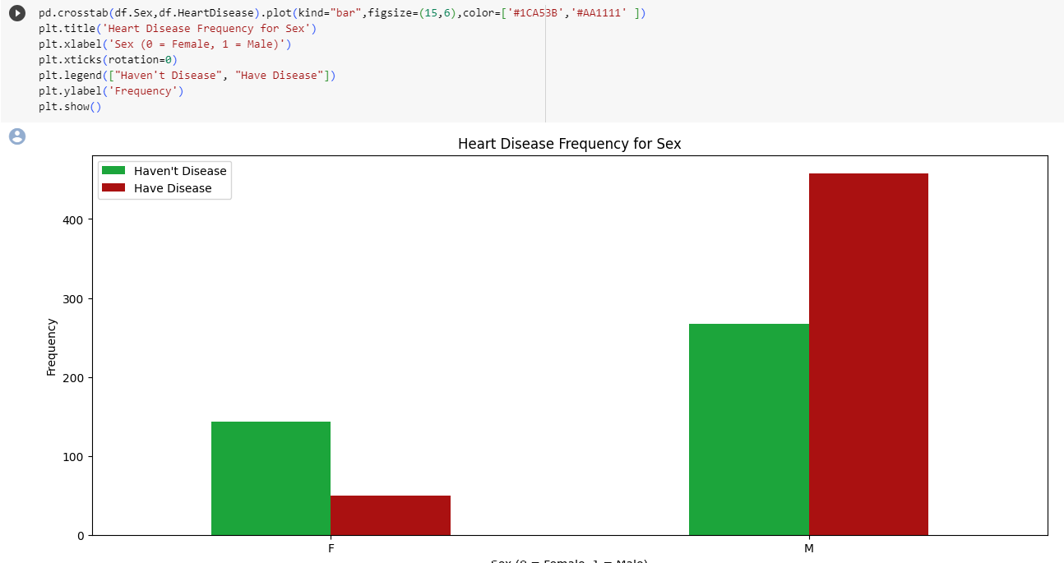
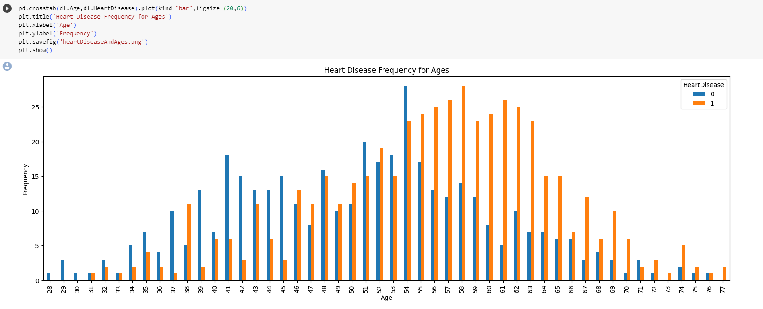
Data Visualization:
Shamshik

Slide 15
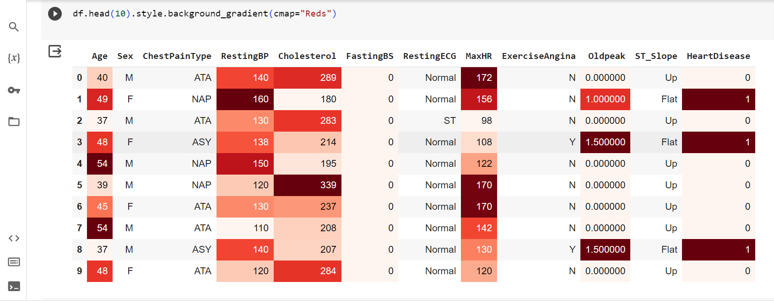
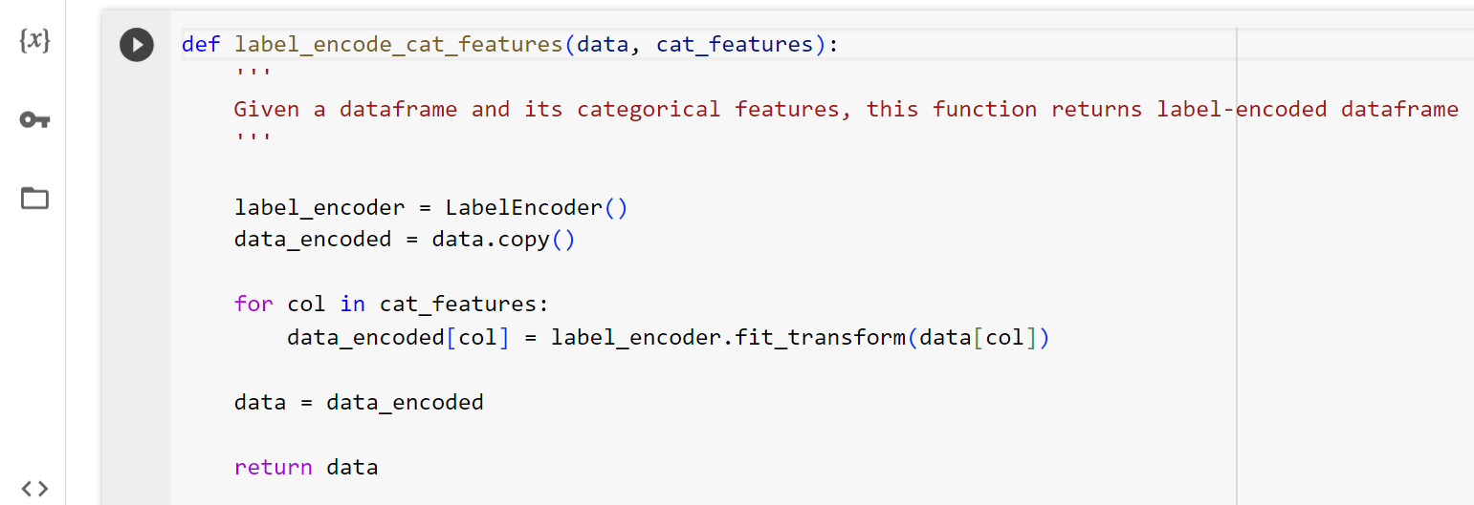
Data Preprocessing:
Data preprocessing is a vital initial stage in data analysis and machine learning.
It involves cleaning, transforming, and structuring raw data for better quality and usability. Key steps include handling missing values, addressing outliers, transforming and encoding data, feature engineering, and data splitting.
Dimensionality reduction and data integration may be needed in more complex scenarios. Visualization aids in understanding the data, and documenting the preprocessing steps is crucial for transparency.
The process is iterative and varies based on the data and project goals. Effective data preprocessing is essential for accurate analysis and successful machine learning, as it ensures data is in the right format and quality for the task.
Tejasree

Slide 16
In data preprocessing we are making the data more suitable for machine learning models that expect numerical inputs. They also utilize domain knowledge to transform and encode categorical features to potentially improve the model's ability to make predictions related to heart disease.
Here, in our dataset we have exercise angina feature that represent whether a patient experiences exercise-induced angina, with values 'Y' for yes and 'N' for no .
In many machine learning algorithms, it's easier to work with numerical values rather than categorical text values. By replacing 'Y' with 1 and 'N' with 0, you are converting this categorical feature into a binary feature where 1 indicates the presence of exercise-induced angina (True) and 0 indicates its absence (False).
Tejasree

Slide 17
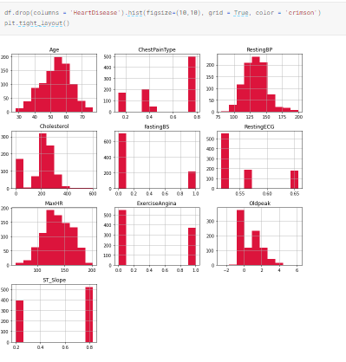
Data Manipulation and Exploration:
Data manipulation and exploration are essential data analysis processes. Data manipulation involves tasks such as cleaning, transforming, and restructuring data to prepare it for analysis.
This includes handling missing values, encoding categorical variables, and feature engineering. Data exploration, on the other hand, involves visualizing and summarizing data to uncover patterns, relationships, and insights.
Techniques like histograms, scatter plots, and statistical measures help in this process. These activities aid in understanding the data's characteristics, identifying outliers, and preparing it for modeling or analysis, ultimately leading to more informed decision-making and valuable insights from the data.
Tejasree

Slide 18
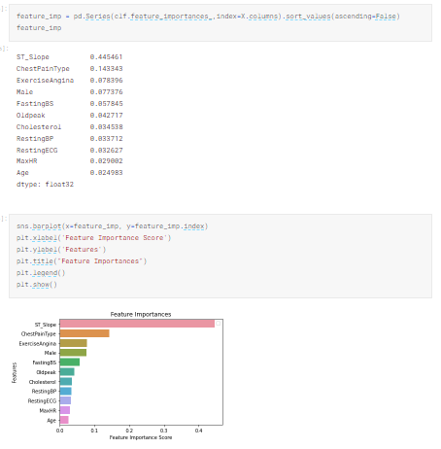
Feature Importance:
Feature importance refers to the assessment of how individual variables or attributes in a dataset influence the outcomes predicted by a machine learning model.
It helps pinpoint which features have the most impact on a model's performance. Methods for determining feature importance include statistical tests, model-based techniques, permutation tests, correlation analysis, and domain expertise.
Understanding feature importance is essential for optimizing models, enhancing interpretability, guiding feature engineering, and identifying critical drivers in various domains.
It plays a pivotal role in simplifying models, explaining predictions, and making informed decisions based on data analysis and machine learning.
Tejasree

Slide 19
Machine learning classifiers used:
SCIKIT -LEARN CLASSIFIERS (Traditional ML classifiers) | BOOSTED TREE CLASSIFIER (Advanced ML classifiers)
Logistic Regression | Catboost
Random Forest | xgboost
AdaBoost | Light GBM
Support Vectors
K-Nearest Neighbor Classifiers
Quadratic DA
Gradient Boosting
Neural Net
Nu SVC
Linear DA
Naive Bayes
decision trees
Satwika

Slide 20
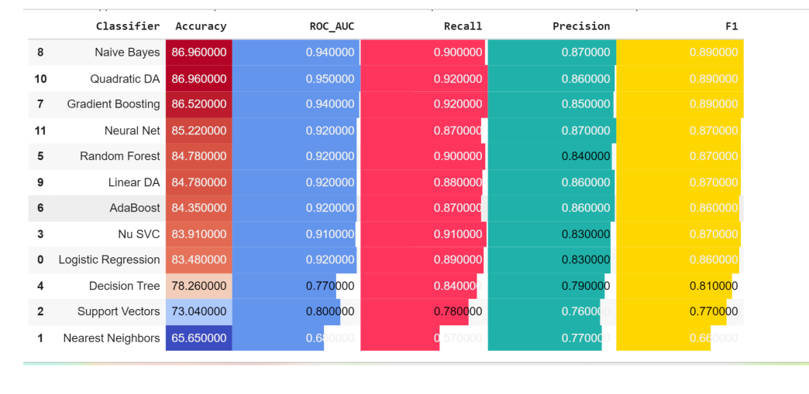
Analysis and Results:
Performance metrics:
Performance measures when data is split into 75% and 25% for training and testing
Satwika

Slide 21
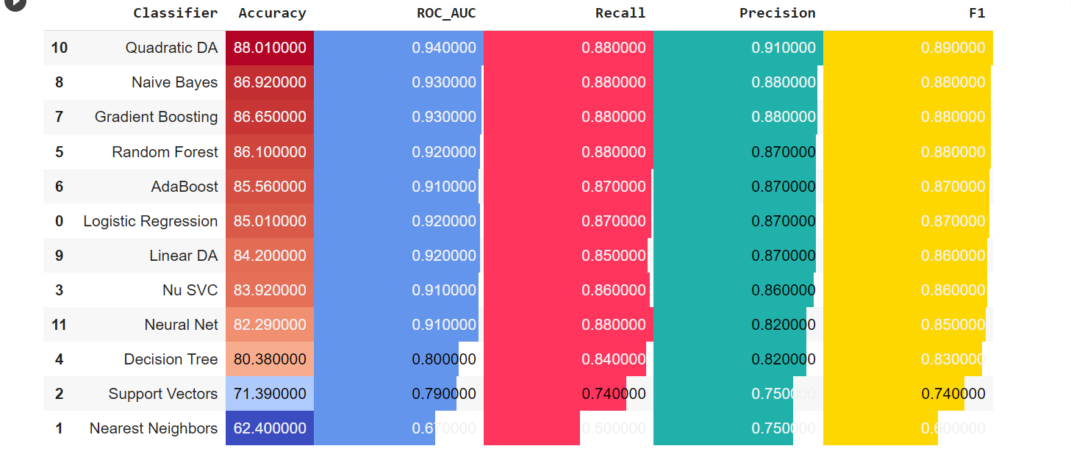
Performance metrics:
Performance measures when data is split into 60% and 40% for training and testing
Satwika

Slide 22
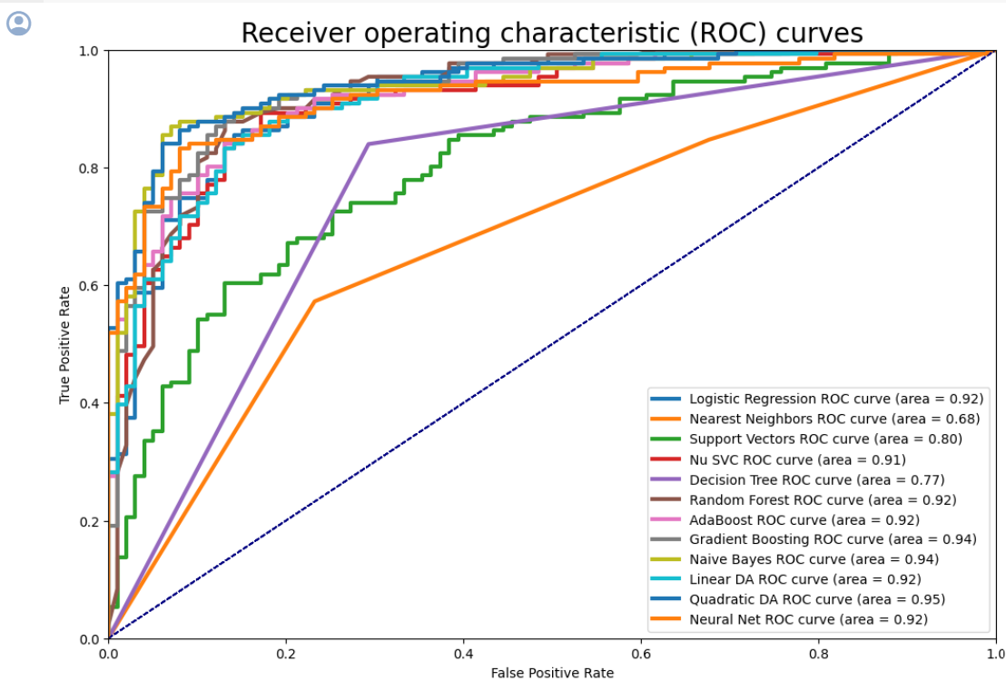
ROC Curves:
The ROC curve is used to assess the overall diagnostic performance of a test and to compare the performance.
Satwika

Slide 23
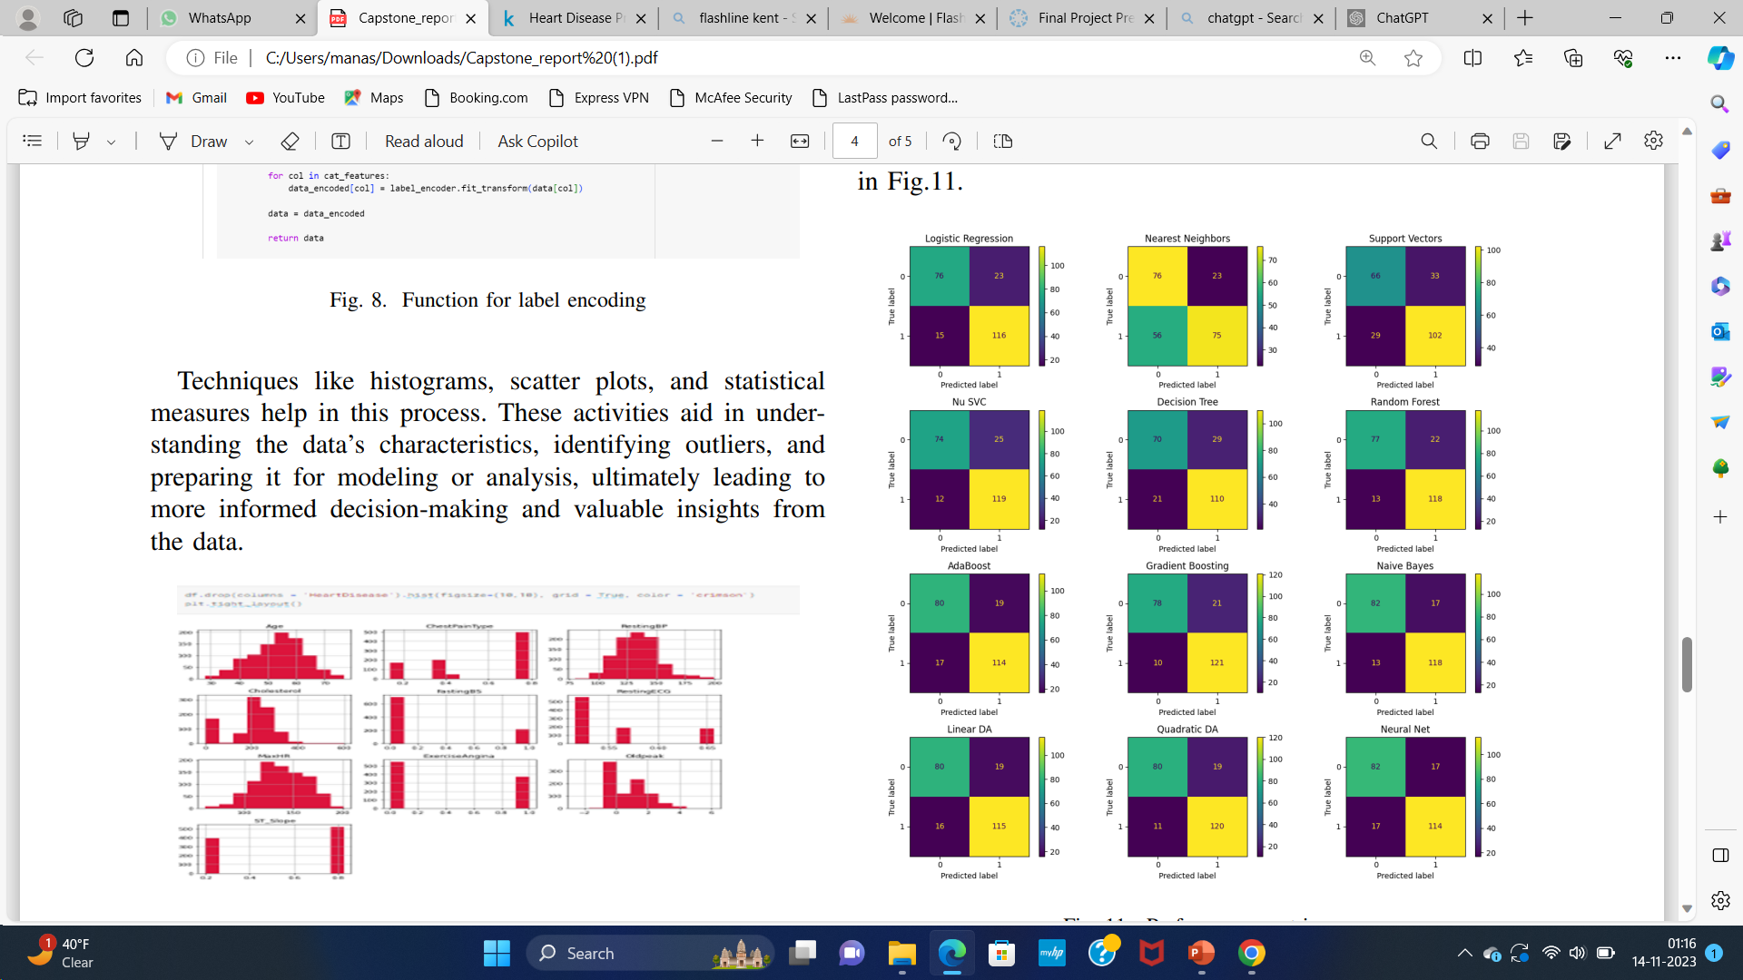
Confusion matrix :
Confusion matrix when data is split into 75% and 25% for training and testing
Satwika

Slide 24
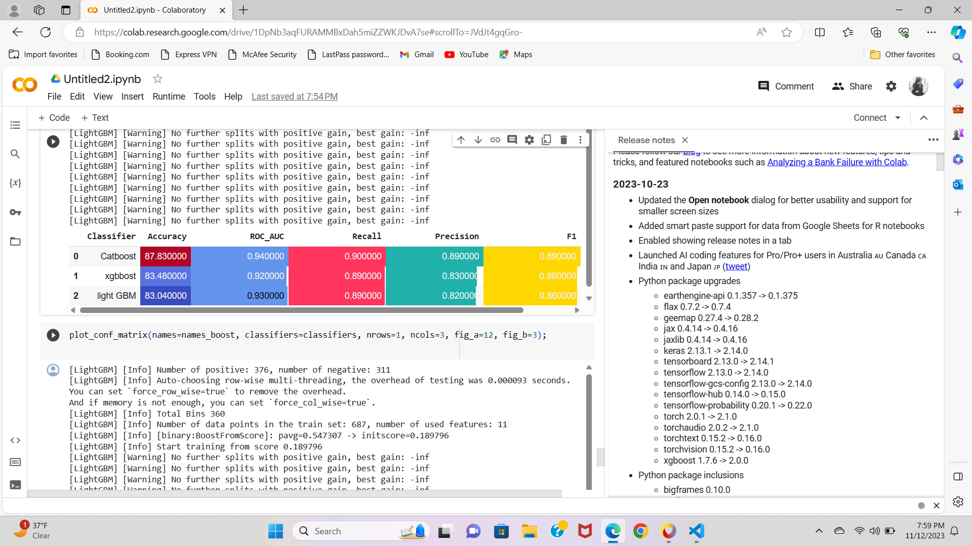
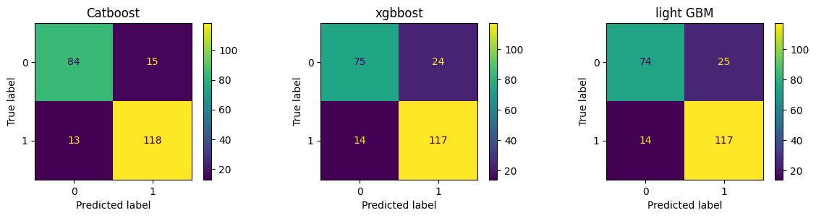
Performance metrics :
Confusion matrix:
Satwika

Slide 25
Analysis:
We initially divided the dataset into 75% and 25% for training and testing our machine learning model. Here Quadratic Discriminant Analysis (Quadratic DA) classifier performed best in terms of Accuracy and Recall. Since we are considering Recall as our main criteria for selecting the best classifier, We can say that Quadratic DA classifier performed the best.
Then we split the dataset into 60% and 40% for training and testing to check how our classifiers work on different splits of data. Here we can say that Quadratic DA classifier still proved to be best in terms of accuracy and Recall.
Then we used Advanced Machine learning classifiers . We can see that catboost classifier performed the best in terms of accuracy, precision, Recall and F1 score. Since we are considering Recall as our main criteria in selecting the best performing classifier, we can say that Catboost classifier is best performing classifier.
Satwika

Slide 26
Summary & Conclusion
Cardiovascular disease (CVD) prediction using machine learning algorithms involves the use of data-driven models to analyze patient data and estimate CVD risk.
Our main goals are to employ comprehensive data visualization to uncover feature-target relationships and identify key features, Enhance dataset quality with more attribute information and utilize the latest dataset, and implement advanced machine learning algorithms to improve heart disease prediction accuracy.
We used the latest and updated dataset with more attributes from UCI website to get better results and we used both traditional and advanced machine learning classifiers to improve overall model performance
By comparing both we got better and fast accuracy in Boosted Tree Classifiers(i.e., Catboost, Xgboost, Light GBM)
Cat boost got the highest Accuracy and performed better in terms of recall and precision. Cat Boost is 30 to 60 times faster than XGBoost and LightGBM.
CatBoost facilitates deep analysis by making it easy to focus on a single feature's contribution to the model, rather than a specific value of a specific feature
Tejasree

Slide 27
Summary & Conclusion
The Catboost got the better accuracy in all the machine learning Classifiers. The Overall accuracy is around 87%.
CatBoost is a robust machine learning algorithm that excels in various areas, including ease of use, categorical feature handling, scalability, accuracy, overfitting prevention, prediction speed, and feature importance analysis.
Due to this reasons the Catboost suits better for our Dataset. If data size is increased also Catboost works efficiently.
Tejasree

Slide 28

Thank you

